Slide 1

Course code ACSE0512 Course Name : Python web development with Django
UNIT-I: Python libraries for web development
Collections-Container datatypes, Tkinter-GUI applications, Requests-HTTP requests, BeautifulSoup4-web scraping, Scrapy, Zappa, Dash, CherryPy, TurboGears, Flask, Web2Py,
Bottle, Falcon, CubicWeb, Quixote, Pyramid.

Slide 2
Unit 1 Content
• Collections-Container datatypes
• Tkinter-GUI applications
• Requests-HTTP requests
• BeautifulSoup4-web scraping
• Scrapy, Zappa, Dash, CherryPy, TurboGears,
• Flask, Web2Py,
• Bottle, Falcon, CubicWeb, Quixote, Pyramid.

Slide 3
Collections-Container data types
The collections module in Python is a built-in module that provides alternatives to Python's general-purpose built-in containers like dict, list, set, and tuple.
Mutable data types in Python
List, Sets, Dictionary means that are changeable after creation
Immutable type
Number, strings, Tuples (these are not change after creation)

Slide 4
List Data type
Lists in Python are implemented as dynamic mutable arrays which hold an ordered collection of items.
l1 = [] # Create an empty list using square brackets.
l2 = [1,2,3,4,5] // similar list items l3 = [1, 2, "3", 4.5] # Create a with different data item.
l4 = list()# Create an empty list using the list() constructor.

Slide 5
Tuple data type
A collection of items which are indexed , ordered and immutable
Syntax typle_name = (item1, item2, item3,…..)
Example
cars= ('Audi', 'Alto', 'i10') // these item have index from 0,1,2 …..so on
Example immutable Cars[0] ="Breeza"
#It will throw error : tuple does not support item assignment.
Tuple can duplicates : Cars = ('Alto','Audi','Audi')
Tuple with item single item :
Syntax tuple_name = (item,) output - Cars = ('Audi',)
len(cars) # no of items in tuple

Slide 6
Tuple conti....
The tuple () constructor : It provide alternative way to create a tuple
Example cars = tuple(('Audi', 'Mercedes', 'BMW')
Access data items index
Cars[1] # positive index
Cars[-1] # negative index –1 is the last item
Access tuple items using slicing
Cars[1:] Output ('Mercedes', 'BMW')
Cars[1:3] Output ('Mercedes', 'BMW')
Cars[:] Output ('Audi', 'Mercedes', 'BMW')

Slide 7
Summary of collection datatypes
STRING | LIST | TUPLE | SET | DICTIONARY
immutable | mutable | immutable | mutable | mutable
Ordered/index | Ordered/index | Ordered/index | unordered | unordered
Allows duplicates | Allows duplicates | Allows duplicates | Not allow | Allows duplicates
Empty string=”” | Empty list =[] | Empty tuple =() | Empty Set=set() | Empty dictionary= {}
Only store string | It can store any datatype, str, list, tuple , dict, int etc | It can store any datatype, str, list, tuple , dict, int etc | Store (int,str,tuple) but not list, set, dictionary. | Inside of dictionary key can be int, str and tuple only values can be any data type, int, str,list, large amt of data

Slide 8
Specialized Container Data types
Specialized container datatypes providing alternatives to Python’s general purpose built-in containers
namedtuple()- factory function for creating tuple subclasses with named fields.
Deque-list-like container with fast appends and pops on either end
ChainMap - dict-like class for creating a single view of multiple mappings
Counter- dict subclass for counting hashable objects

Slide 9
Specialized Container Data types conti…..
OrderedDict-dict subclass that remembers the order entries were added
Defaultdict-dict subclass that calls a factory function to supply missing values
UserDict-wrapper around dictionary objects for easier dict sub classing
UserList-wrapper around list objects for easier list sub classing
UserString-wrapper around string objects for easier string sub classing

Slide 10
Specialized Container Data types conti…..
namedtuple()
Is a function in Python's collections module. It is used to create tuple-like objects with named fields, allowing for more readable code.
Example1
from collections import namedtuple
Point = namedtuple('Point', ['x', 'y'])
p = Point(10, 20)
print(p.x, p.y) # Output: 10 20

Slide 11
namedtuple() continue...
Important points
student1 = Student(name='Alice', age=20, grade='A')
# instance of Access by name, and by index
Namedtuples are immutable, so trying to modify a field will raise an error for example
student1.age = 21 # This will raise an AttributeError
It easily convert into dictionary
student_dict = student1._asdict() print(student_dict)
# Output: {'name': 'Alice', 'age': 20, 'grade': 'A'}
Namedtuples support unpacking
name, age, grade = student1
print(f"{name} is {age} years old and got a grade of {grade}.")

Slide 12
Deque
Deque is (double ended queue )
To implemented using collection modules.
We can access the front element of the deque using indexing with deq[0]
We can access the back element of the deque using indexing with deq[-1]
Deque is preferred over a list in the cases.
Where we need quicker append and pop operations from both the ends of the container.
deque provides an O(1) time complexity for append and pop operations as compared to a list that provides O(n) time complexity.

Slide 13
deque()
from collections import deque
# Declaring deque
queue = deque(['name','age','DOB'])
print(queue)

Slide 14
Operations on deque
Appending Items
Append() : This function is used to insert the value in its argument to the right end of the deque.
appendleft() : This function is used to insert the value in its argument to the left end of the deque.
To implement these operations we need to
import collections

Slide 15
Operations on deque
# importing "collections" for deque operations import collections
# initializing deque deq_lst = collections.deque([1, 2, 3]) print("deque: ", deq_lst)
//inserts element at the end of deque deq_lst.append(8)
print("\n The deque after append");
print(deq_lst);
deq_lst.appendleft(6)
print(deq_lst);

Slide 16
Pop items from deque
pop(): This function is used to delete an argument from the right end of the deque.
popleft(): This function is used to delete an argument from the left end of the deque.
import collections
# initializing deque deq_lst = collections.deque([1, 2, 3, 6 ,8,10]) print("deque: ", deq_lst)
#Delete item from end deq_lst.pop()
print("\n The deque after pop");
print(deq_lst);
deq_lst.popleft()
print(deq_lst);

Slide 17
Accessing Items in a deque
index(ele, beg, end) : This function returns the first index of the value mentioned in arguments, starting searching from beg till end index.
deq_lst = collections.deque([1, 2, 3, 3, 4, 2, 4])
print ("The number 4 first occurs at a position : ") print(deq_lst.index(4,2,5))
insert(i, a) : This function inserts the value mentioned in arguments(a) at index(i) specified in arguments.
# using insert() to insert the value 3 at 5th position deq_lst.insert(4,3)

Slide 18
Accessing Items in a deque
remove():- This function removes the first occurrence of the value mentioned in arguments.
de.remove(2)
count():- This function counts the number of occurrences of value mentioned in arguments.
print (deq_lst.count(3))

Slide 19
ChainMap
Python contains a container called “ChainMap” which encapsulates many dictionaries into one unit.
from collections import ChainMap
d1 = {'a': 1, 'b': 2} d2 ={'c': 3, 'd': 4}
d3 = {'e': 5, 'f': 6}
# Defining the chainmap
c = ChainMap(d1, d2, d3)
print(c)
#ChainMap({'a': 1, 'b': 2}, {'c': 3, 'd': 4}, {'e': 5, 'f': 6})

Slide 20
ChainMap Access Operations
maps() : This function is used to display keys with corresponding values of all the dictionaries in ChainMap.
# printing chainMap using maps
print ("All the ChainMap contents are : ")
print (chain.maps)
keys() : This function is used to display all the keys of all the dictionaries in ChainMap.
print ("All keys of ChainMap are : ") print (list(chain.keys())) # printing keys using keys()
values() : This function is used to display values of all the dictionaries in ChainMap.
# printing keys using keys() print ("All values of ChainMap are : ") print (list(chain.values()))

Slide 21
Counter container
Counter is an unordered collection where elements are stored as Dict keys and their count as dict value.
Counter elements count can be positive, zero or negative integers.
There is no restriction on it’s keys and values. Although values are intended to be numbers but we can store other objects too.
Three ways to initialized counter
import collections
print collections.Counter(['a', 'b', 'c', 'a', 'b', 'b'])
print collections.Counter({'a':2, 'b':3, 'c':1})
print collections.Counter(a=2, b=3, c=1)

Slide 22
Counter container
from collections import Counter
# empty Counter
counter = Counter()
print(counter) # Counter()
# Counter with initial values
counter = Counter(['a', 'a', 'b'])
print(counter) # Counter({'a': 2, 'b': 1})
counter = Counter(a=2, b=3, c=1)
print(counter) # Counter({'b': 3, 'a': 2, 'c': 1})

Slide 23
Counter container conti…..
We can also use any Iterable as argument for creating Counter object.
STRING LITEREAL and LIST can be used too for creating Counter object.
from collections import Counter
# Iterable as argument for Counter
counter = Counter('abbbc')
print(counter) # Counter({'a': 1, 'b': 1, 'c': 1})
# List as argument to Counter
words_list = ['Cat', 'Dog', 'Horse', 'Dog','Bull']
counter = Counter(words_list)
print(counter) # Counter({'Dog': 2, 'Cat': 1, 'Horse': 1})
# Dictionary as argument to Counter
word_count_dict = {'Dog': 2, 'Cat': 1, 'Horse': 1}
counter = Counter(word_count_dict)
print(counter) # Counter({'Dog': 2, 'Cat': 1, 'Horse': 1})
'Horse': 1})

Slide 24
DefaultDict
The defaultdict tool is a container in the collections class of Python. It's similar to the usual dictionary (dict) container, but the only difference is that a defaultdict will have a default value if that key has not been set yet.
This can help avoid KeyError exceptions.

Slide 25
DefaultDict
Defaultdict is a sub-class of the dictionary class that returns a dictionary-like object.
Syntax: defaultdict(default_factory)
from collections import defaultdict
# Initialize a defaultdict with int as the default factory
# This means any new key will have a default value of 0
word_count = defaultdict(int)

Slide 26
DefaultDict example
from collections import defaultdict
words = ["apple", "banana", "apple", "orange", "banana", "apple"]
# Initialize defaultdict with int as the default factory
word_count = defaultdict(int)
for word in words:
word_count[word] += 1 # Automatically initializes to 0 if the key doesn't exist
print(word_count)
#output
defaultdict(<class 'int'>, {'apple': 3, 'banana': 2, 'orange': 1})

Slide 27
Ordered Dict
OrderedDict is another specialized dictionary provided by Python's collections module.
It is similar to a regular dictionary but with an additional feature: it remembers the order in which items are inserted.
This is particularly useful when the order of elements is important, such as when you want to preserve the sequence of operations or when you need to produce consistent outputs.

Slide 28
Ordered Dict
from collections import OrderedDict
# Initialize an empty OrderedDict
ordered_dict = OrderedDict()
# Adding items to the OrderedDict
ordered_dict["banana"] = 3
ordered_dict["apple"] = 4
ordered_dict["orange"] = 1
print(ordered_dict)
#output
OrderedDict([('banana', 3), ('apple', 4), ('orange', 1)])

Slide 29
Ordered Dict Reordering Elements
from collections import OrderedDict
# Initialize an OrderedDict
ordered_dict = OrderedDict()
# Insert items
ordered_dict["banana"] = 3
ordered_dict["apple"] = 4
ordered_dict["orange"] = 2
print("Before reordering:", ordered_dict)
# Move 'banana' to the end
ordered_dict.move_to_end("banana")
print("After reordering:", ordered_dict)

Slide 30
Python - GUI Programming (Tkinter)
Tkinter − Tkinter is the Python interface to the Tk GUI toolkit shipped with Python. We would look this option in this chapter.
Tkinter Programming
Tkinter is the standard GUI library for Python. Python when combined with Tkinter provides a fast and easy way to create GUI applications. Tkinter provides a powerful object-oriented interface to the Tk GUI toolkit.

Slide 31
Python - GUI Programming (Tkinter)
Creating a GUI application using Tkinter is an easy task. All you need to do is perform the following steps −
Import the Tkinter module.
Create the GUI application main window.
Add one or more widgets to the GUI application.
Enter the main event loop to take action against each
event triggered by user.

Slide 32
Python - GUI Programming (Tkinter)
To main approaches has to follow after importing tkinter
1 Tk() - Tk is used to create main window
2. mainloop() - it is an infinite loop, that run the applications,
wait for the event, and processes it as soon as the window
open.
from tkinter import *
main_window = Tk()
main_window.mainloop()

Slide 33
Widgets
Where to put widgets?
Between main window and main loop
Tkinkter offers many controls in a GUI application, such as buttons, labels,and textboxes etc.
Widgets are the general name for these controls
Different type of widgets present in Tkinter are
Label, button, entry, checkbutton, canvas,frame

Slide 34
Geometry Management(in Tkinter)
All Tkinter widgets have access to specific geometry management methods, which have the purpose of organizing widgets throughout the parent widget area. Tkinter exposes the following geometry manager classes: pack, grid, and place.
First we use geometry configuration of widgets
There are primarily three types of geometry manager classes.
Pack() : it is used to place a widget on top
Grid() : it is used to organize the widgets in table like structure
Place() : it is used to organize widgets at specific position

Slide 35
Geometry Management(in Tkinter)
For specific position we use x,y variables , let suppose x = 10 means from position left to right I am placing that widget
And if we use y=50 means from top to bottom

Slide 36
Widgets (in Tkinter)
We present these widgets as well as a brief description in the following table −
Operator & Description
Button
The Button widget is used to display buttons in your application.
Canvas
The Canvas widget is used to draw shapes, such as lines, ovals, polygons and rectangles, in your application.
Checkbutton
The Checkbutton widget is used to display a number of options as checkboxes. The user can select multiple options at a time.

Slide 37
Widgets (in Tkinter) continue…
Entry
The Entry widget is used to display a single-line text field for accepting values from a user
Frame
The Frame widget is used as a container widget to organize other widgets.
Label
The Label widget is used to provide a single-line caption for other widgets. It can also contain images.
Listbox
The Listbox widget is used to provide a list of options to a user.

Slide 38
HTTP - Requests
GET and POST requests using Python
HTTP (Hypertext Transfer Protocol) request methods GET and POST requests in Python and their implementation in python.
What is HTTP?
HTTP is a set of protocols designed to enable communication between clients and servers. It works as a request-response protocol between a client and server. A web browser may be the client, and an application on a computer that hosts a website may be the server.
So, to request a response from the server, there are mainly two methods:
1.GET : to request data from the server.
2.POST : to submit data to be processed to the server.

Slide 39
HTTP - Requests
GET Request
A GET request is used to request data from a specified resource on a server. It's typically used to retrieve information from the server, like web pages, images, or data in formats like JSON or XML.
POST Request
POST request is used to send data to a server to create or update a resource. It's typically used when you need to submit form data, upload a file, or perform an operation that changes data on the server.

Slide 40
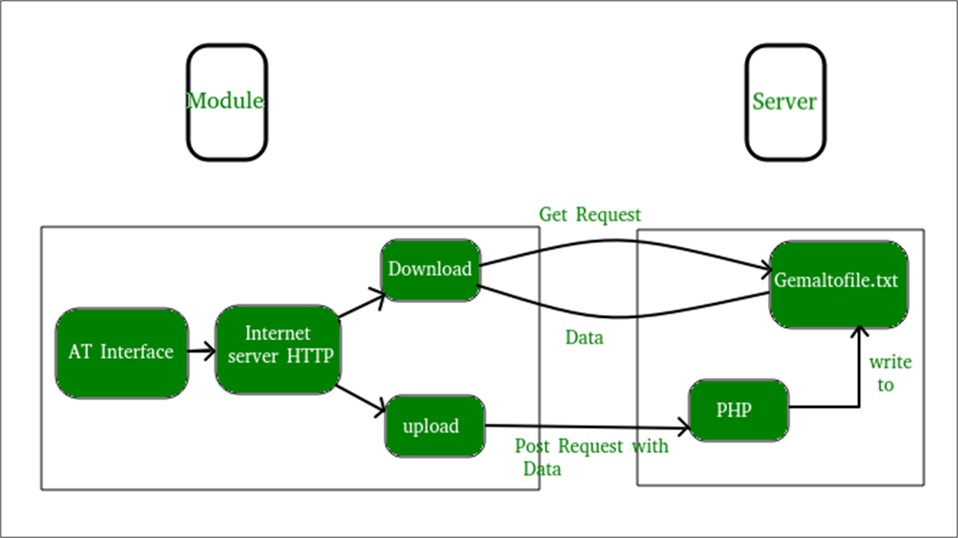
Basic concept of GET and POST methods

Slide 41
HTTP - Requests
 | GET | POST
Purpose | Retrieve data | Send data
Data Location | In the URL (query parameters) | In the request body
Caching | Often cached | Not cached
Security | Less secure (data visible in URL) | More secure (data in the body)

Slide 42
Beautiful Soup 4-web scraping
What is Web Scraping?
Web scraping is the process of extracting data from websites.
It involves making requests to a website and parsing the data to retrieve specific information.
What is Beautiful Soup?
Beautiful Soup is a Python library used for web scraping purposes to pull data out of HTML and XML files.
It creates a parse tree from the page source code that can be used to extract data easily.
providing Pythonic idioms for iterating, searching, and modifying the parse tree.

Slide 43
Beautiful Soup 4-web scraping
Installation of Beautiful Soup
pip install beautifulsoup4 pip
2. Install requests
You will also need the requests library to make HTTP
requests to fetch the content of web pages.
Steps for Web Scraping
import requests from bs4
import BeautifulSoup
Make a Request Use the requests library to fetch the HTML content of the webpage:

Slide 44
Beautiful Soup 4-web scraping
url = 'https://example.com'
response = requests.get(url)
html_content = response.text
Create a BeautifulSoup Object
Parse the HTML content with BeautifulSoup:
soup = BeautifulSoup(html_content, 'html.parser')
The html.parser argument is the parser you want to use. You can also use lxml or html5lib for parsing.

Slide 45
Beautiful Soup 4-web scraping
url = 'https://example.com'
response = requests.get(url)
html_content = response.text
Create a BeautifulSoup Object
Parse the HTML content with BeautifulSoup:
soup = BeautifulSoup(html_content, 'html.parser')
The html.parser argument is the parser you want to use. You can also use lxml or html5lib for parsing.

Slide 46
Zappa
Zappa is a way to deploy serverless web apps on AWS Lambda.
Zappa is a very powerful open source python project which lets you build, deploy and update your WSGI app hosted on AWS Lambda + API Gateway easily.
Zappa is a Python package that bundles up web apps written in Flask or Django and deploys them to AWS (Amazon Web Services) Lambda.

Slide 47
Zappa
Lambda is Amazon's function as a service (FaaS) platorm.
Why is Zappa so great?
Because instead of deploying your Flask or Django web app on a cloud server, like an AWS EC2 instance or a Digital Ocean Droplet, you can deploy your app server less as an AWS Lambda function.
This isn't really "serverless" (servers run AWS Lambda), but with an AWS Lambda function, you don't have to spin up servers, install packages, make sure security patches are up to date, and most of all: you don't have to pay for server time that isn't used.
A cloud server has to run all the time, whether or not someone visits your website. But an AWS Lambda function only runs when requested.

Slide 48
Dash Framework
Dash is an open-source Python framework used for building analytical web applications.
It is a powerful library that simplifies the development of data-driven applications.
It’s especially useful for Python data scientists who aren’t very familiar with web development. Users can create amazing dashboards in their browser using dash.
Built on top of Plotly.js, React, and Flask, Dash ties modern UI elements like dropdowns, sliders and graphs directly to your analytical python code.

Slide 49
Dash Framework
Dash apps consist of a Flask server that communicates with front-end React components using JSON packets over HTTP requests.
Dash applications are written purely in python, so NO HTML or JavaScript is necessary.
Dash or App Layout
Dash apps are composed of two parts. The first part is the “layout” of the app which basically describes how the application looks like.
The second part describes the interactivity of the application.

Slide 50
Dash Framework
Core Components
We can build the layout with the dash_html_components and the dash_core_components library.
Dash provides python classes for all the visual components of the application. We can also customize our own components with JavaScript and React.js.
import dash_core_components as dcc
import dash_html_components as html
The dash_html_components is for all HTML tags where the dash_core_components is for interactivity built with React.js.

Slide 51
Dash Framework
import dash
from dash import dcc, html
app = dash.Dash(__name__)
app.layout = html.Div(children=[
html.H1('Hello Dash!'),
html.Div('This is a simple Dash app with a graph.'),
# Add a simple line graph
dcc.Graph(
id='example-graph',
figure={
'data': [
{'x': [1, 2, 3, 4], 'y': [4, 1, 3, 5], 'type': 'line', 'name': 'Sample Data'},
],
'layout': {
'title': 'Simple Line Graph'
}
}
)
])
if __name__ == '__main__':
app.run_server(debug=True)

Slide 52
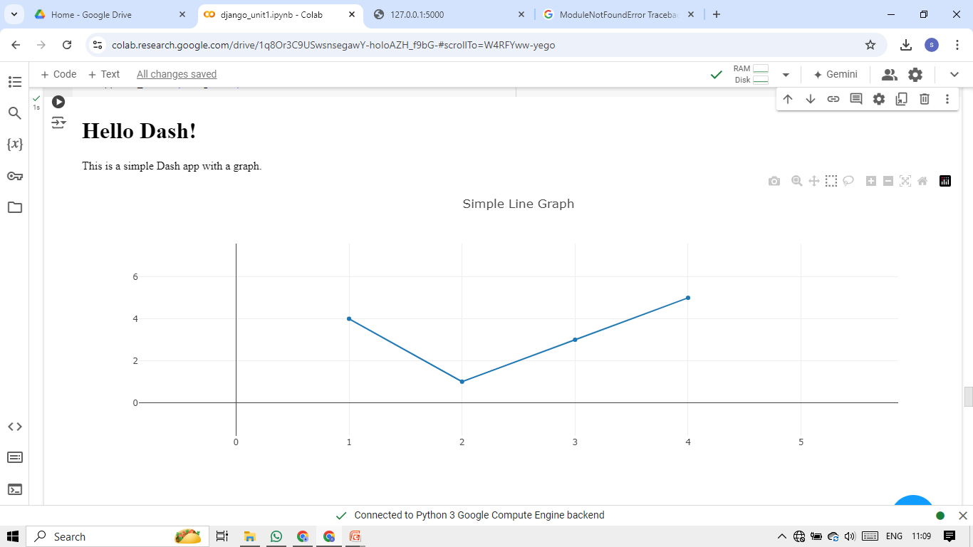
Output of dash board program

Slide 53
Cherry Py
CherryPy allows developers to build web applications in much the same way they would build any other object-oriented Python program.
This results in smaller source code developed in less time. It is being used in many production websites.
CherryPy is a web framework of Python which provides a friendly interface to the HTTP protocol for Python developers.
It is also called a web application library.
CherryPy uses Python’s strengths as a dynamic language to model and bind HTTP protocol into an API.
It is one of the oldest web frameworks for Python, which provides clean interface and reliable platform.

Slide 54
Cherry Py continue……
Strengths of CherryPy
The following features of CherryPy are considered as its strengths −
Simplicity
Developing a project in CherryPy is a simple task with few lines of code developed as per the conventions and indentations of Python.
CherryPy is also very modular. The primary components are well managed with correct logic concept and parent classes are expandable to child classes.
Power
CherryPy leverages all the power of Python. It also provides tools and plug-in, which are powerful extension points needed to develop world-class applications.
Open-source
CherryPy is an open-source Python Web Framework (licensed under the open-source BSD license), which means this framework can be used commercially at ZERO cost.

Slide 55
Cherry Py continue……
Community Help
It has a devoted community which provides complete support with various types of questions and answers. The community tries to give complete assistance to the developers starting from the beginner level to the advanced level.
Deployment
There are cost effective ways to deploy the application. CherryPy includes its own production-ready HTTP server to host your application. CherryPy can also be deployed on any WSGI(Web Server Gateway Interface)-compliant gateway.
CherryPy comes in packages like most open-source projects, which can be downloaded and installed in various ways which are mentioned as follows −
Using a Tarball
Using easy_install
Using Subversion

Slide 56
Features of Cherry Py
A reliable, HTTP/1.1-compliant, WSGI thread-pooled webserver.
Easy to run multiple HTTP servers (e.g. on multiple ports) at once.
A powerful configuration system for developers and deployers alike.
A flexible plug-in system.
Built-in tools for caching, encoding, sessions, authentication, static content, and many more.
Swappable and customizable...everything.
Built-in profiling, coverage, and testing support.
Runs on Python 2.7+, 3.5+, PyPy( PyPy uses just-in-time (JIT) compilation to translate Python code into machine-native assembly language.) Jython and Android.

Slide 57
Turbo Gears
TurboGears is a Python web application framework, which consists of many modules. It is designed around the MVC architecture that are similar to Ruby on Rails or Struts. TurboGears are designed to make rapid web application development in Python easier and more supportable.
TurboGears is a web application framework written in Python.
TurboGears follows the Model-View-Controller paradigm as do most modern web frameworks like Rails, Django, Struts, etc. This is an elementary tutorial that covers all the basics of TurboGears.
TurboGears is a web application framework written in Python. Originally created by Kevin Dangoor in 2005, its latest version TurboGears (ver 2.3.7) is managed by a group of developers led by Mark Ramm and Florent Aide.
TurboGears follows the Model-View-Controller paradigm as do most modern web frameworks like Rails, Django, Struts, etc.

Slide 58
Flask
Flask is a web application framework written in Python.
Armin Ronacher, who leads an international group of Python enthusiasts named Pocco, develops it.
Flask is based on Werkzeug WSGI (Web Server Gateway Interface)toolkit and
Jinja2 template(Jinja is a fast, expressive, extensible templating engine. Special placeholders in the template allow writing code similar to Python syntax. Then the template is passed data to render the final document.) engine.
Both are Pocco projects.
Flask is often referred to as a micro framework.
It aims to keep the core of an application simple yet extensible.
Flask does not have built-in abstraction layer for database handling, nor does it have form a validation support.
Instead, Flask supports the extensions to add such functionality to the application.
Importing flask module in the project is mandatory. An object of Flask class is our WSGI(Web Server Gateway Interface) application

Slide 59
Flask
Flask constructor takes the name of current module (__name__) as argument.
The route() function of the Flask class is a decorator, which tells the application which URL should call the associated function.
app.route(rule, options)
The rule parameter represents URL binding with the function.
The options is a list of parameters to be forwarded to the underlying Rule object.
In the above example, ‘/’ URL is bound with hello_world() function. Hence, when the home page of web server is opened in browser, the output of this function will be rendered.
Finally the run() method of Flask class runs the application on the local development server.
app.run(host, port, debug, options)

Slide 60
Flask
Debug mode
A Flask application is started by calling the run() method.
However, while the application is under development, it should be restarted manually for each change in the code. To avoid this inconvenience, enable debug support.
The server will then reload itself if the code changes. It will also provide a useful debugger to track the errors if any, in the application.
Modern web frameworks use the routing technique to help a user remember application URLs. It is useful to access the desired page directly without having to navigate from the home page.
The route() decorator in Flask is used to bind URL to a function. For example −
@app.route(‘/hello’)def hello_world():
return ‘hello world’

Slide 61
Flask
Debug mode
A Flask application is started by calling the run() method.
However, while the application is under development, it should be restarted manually for each change in the code. To avoid this inconvenience, enable debug support.
The server will then reload itself if the code changes. It will also provide a useful debugger to track the errors if any, in the application.
Modern web frameworks use the routing technique to help a user remember application URLs. It is useful to access the desired page directly without having to navigate from the home page.
The route() decorator in Flask is used to bind URL to a function. For example −
@app.route(‘/hello’)def hello_world():
return ‘hello world’

Slide 62
Web2py
web2py is defined as a free, open-source web framework for agile development which involves database-driven web applications. It is written and programmable in Python. It is a full-stack framework and consists of all the necessary components a developer needs to build fully functional web applications.
web2py is defined as a free, open-source web framework for agile development which involves database-driven web applications; it is written in Python and programmable in Python. It is a full-stack framework; it consists of all the necessary components, a developer needs to build a fully functional web application.
web2py framework follows the Model-View-Controller pattern of running web applications unlike traditional patterns.

Slide 63
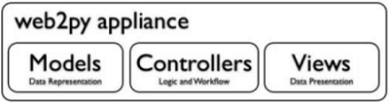
Web2py
web2py has an in-built feature to manage cookies and sessions. After committing a transaction (in terms of SQL), the session is also stored simultaneously.
web2py has the capacity of running the tasks in scheduled intervals after the completion of certain actions. This can be achieved with CRON.

Slide 64
Bottle
Bottle is a fast, simple and lightweight WSGI micro web-framework for Python. It is distributed as a
single file module. There are no dependencies other than the Python Standard Library.
Routing: Requests to function-call mapping with support for clean and dynamic URLs.
Templates: Fast and pythonic built-in template engine and support or mako, jinja2 and cheetah templates.
Utilities: Convenient access to form data, file uploads, cookies, headers and other HTTP features.
Server : Built-in HTTP development server and support for a wide range of WSGI capable HTTP server (e.g. gunicorn, paste or cheroot).
It is suitable of embedded systems and IOT devices.
It is famous for simplicity and speed. It provide a full frame work in a single page.
It can be extended through plug-in (to add additional functionality data base calling , session handling etc)
It useful for implementing small and medium size applications.

Slide 65
Bottle
This framework can be used for micro services.
It is useful for making RESTFul API
It support custom error handling
The Web Server Gateway Interface (WSGI)
It is a specification that describes how a web server communicates with web applications, and how web applications can be chained together to process one request.
Bottle installation
$ sudo pip3 install bottle
We use the pip3 tool to install Bottle.

Slide 66
Falcon
Falcon is a WSGI-compliant web framework designed to build RESTful(Representational State Transfer) APIs without requiring external code library dependencies.
Falcon resources
Building Very Fast App Backends with Falcon Web Framework on PyPy provides a walkthrough of a web API in Falcon that runs with PyPy and Nginx.
Asynchronous Tasks with Falcon and Celery shows how to configure Celery with the framework.
The official Falcon tutorial has a meaty guide for building and deploying your first Falcon web application.
Building Scalable RESTful APIs with Falcon and PyPy shows a to-do list example with Falcon running on PyPy.

Slide 67
CubicWeb
CubicWeb is an open-source Python Web framework . It promotes reusability through the usage of components (called cubes).
CubicWeb is well-defined Python semantic web application framework that focuses on quality, reusability and efficiency of the development solution.
CubicWeb stands out among other Python web frameworks and is not easy to learn. It positions itself as semantic web development framework and gives developers opportunity to build web applications by following the well known object-oriented design principles and reusing components called cubes.
Cube is the core concept of the CubicWeb. Basically it is a minimal web application - a software component that consists of three main parts: data model (schema), the logic (entities) needed to manipulate that data, and user interface (views) that displays the data.

Slide 68
CubicWeb
How CubicWeb works
This development tool is written in Python and includes a web engine and a data server. The web engine replies to http requests and provides a CRUD user interface based on the data model of the instance. The data server publishes data gathered from data repositories. Although app construction is data-driven, CubicWeb is not just a database Web-client construction set.
CubicWeb contains data repository that enables access to one or more data sources such as SQL databases, LDAP repositories, filesystems, Google App Engine’s DataStore, and even other CubicWeb instance repositories. A data repository can be configured to either be accessed remotely using Pyro (Python Remote Objects) or act as a standalone server, that in turn can be accessed either via a standalone web engine or directly. Usually the web engine and the repository are run in the same process.

Slide 69
Quixote
Quixote is a framework for writing Web-based applications using Python. Its goals are flexibility and high-performance, in that order.
Quixote applications tend to be structured like traditional applications. The logic for formatting web pages consists of Python classes and functions. Separation of presentation logic and "back-end" logic is not enforced by Quixote. Instead, you are encouraged to use traditional techniques. For example, a solution is to put presentation logic in its own sub-package.
There are three major versions of Quixote, version 1, 2 and 3. Versions 1 and 2 are similar to each other but incompatible. Version 1 is no longer actively maintained. Version 3 of Quixote requires Python 3 but is otherwise similar to Quixote 2. Versions 2 and 3 of Quixote are actively maintained and are used by numerous public sites.

Slide 70
Quixote
Download
The latest stable version of Quixote (Python 3 only) is version 3.5 (3.4 sig), released 2021-06-12.
The version of the 2.x series (Python 2 compatible) is version 2.9.1 (2.9.1 sig), released 2016-04-18.
The latest version of the 1.x series is Quixote is version 1.3, released 2008-08-21.
The latest test version of Quixote is version 3.6a2 (3.6a2 sig), released 2021-12-20

Slide 71
Pyramid
Pyramid makes it easy to write web applications. You can start small with this "hello world" minimal request/response web app.
This may take you far, especially while learning. As your application grows, Pyramid offers many features that make writing complex software take less effort.
Pyramid works in all supported versions of Python.
Pyramid is a general, open source, web application development framework built in python. It allows python developer to create web applications with ease.

Slide 72
Pyramid
Installing, starting up and configuring
As described, “the start small, finish big, stay finished framework”, Pyramid is much like Flask which takes very little effort to install and run.
In fact, you’ll recognize that some of the patterns are similar to Flask once you start building this application.
Following are the steps to create pyramid framework environment −
First, create a project directory. Here, we have created a directory named pyramidProject (you can choose any name you want).
Next, create a virtual environment where you will install all the project specific dependencies. Here, we created a virtual environment folder named pyramidEnv where Pyramid is installed.
Then, go to the directory, pyramidEnv and install the pyramid with pip install pyramid.

Slide 73
Pyramid
Installing, starting up and configuring
As described, “the start small, finish big, stay finished framework”, Pyramid is much like Flask which takes very little effort to install and run.
In fact, you’ll recognize that some of the patterns are similar to Flask once you start building this application.
Following are the steps to create pyramid framework environment −
First, create a project directory. Here, we have created a directory named pyramidProject (you can choose any name you want).
Next, create a virtual environment where you will install all the project specific dependencies. Here, we created a virtual environment folder named pyramidEnv where Pyramid is installed.
Then, go to the directory, pyramidEnv and install the pyramid with pip install pyramid.

